Slide 1
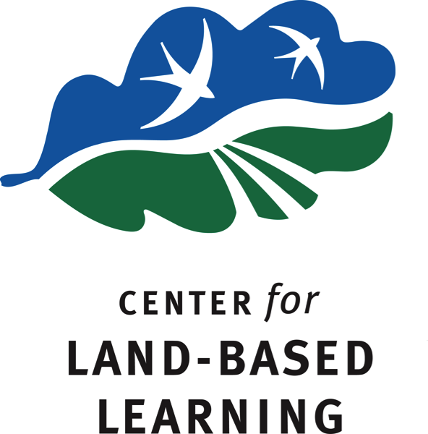
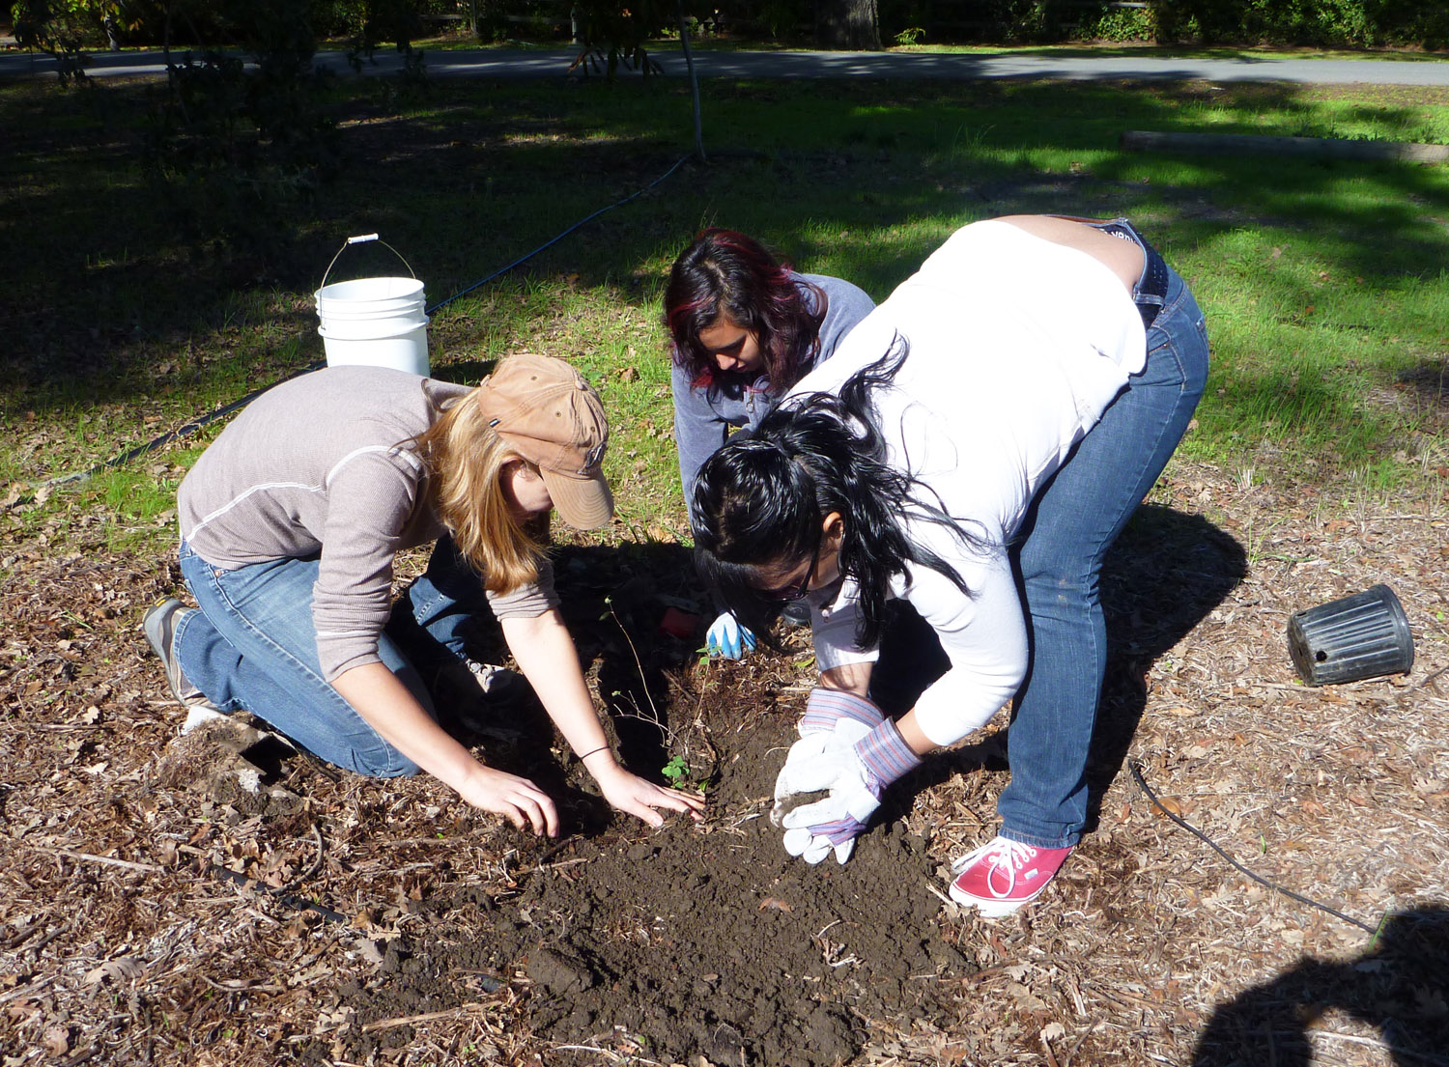
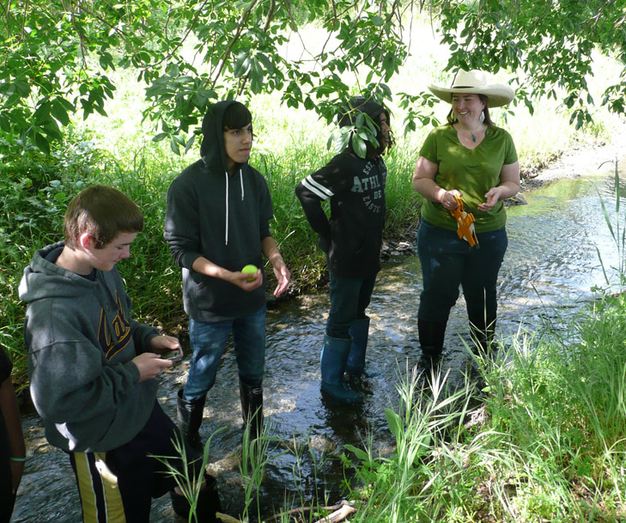
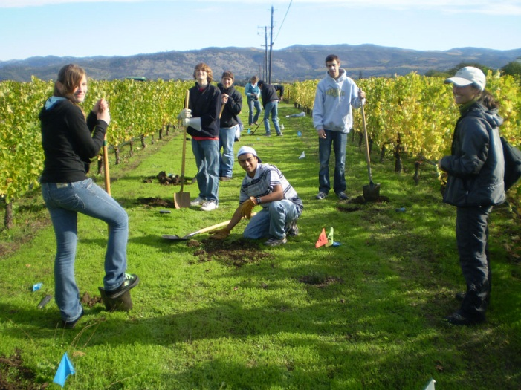
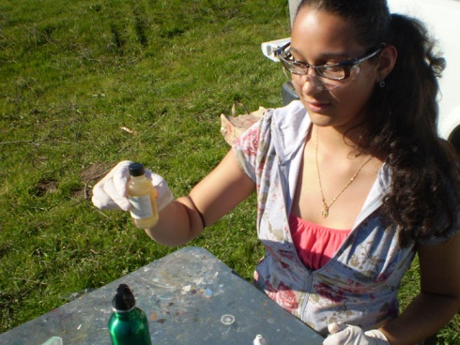
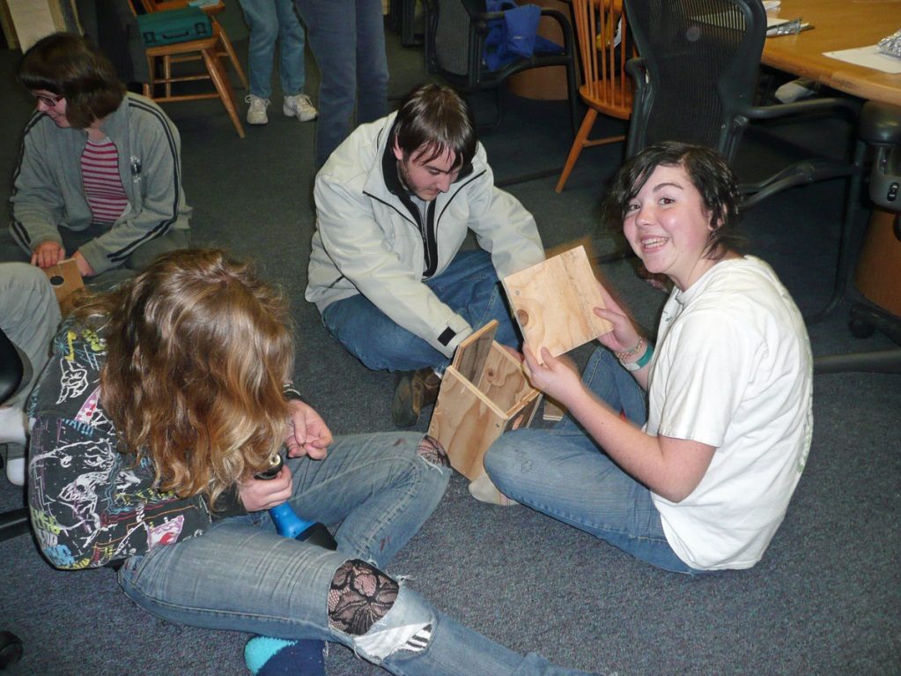
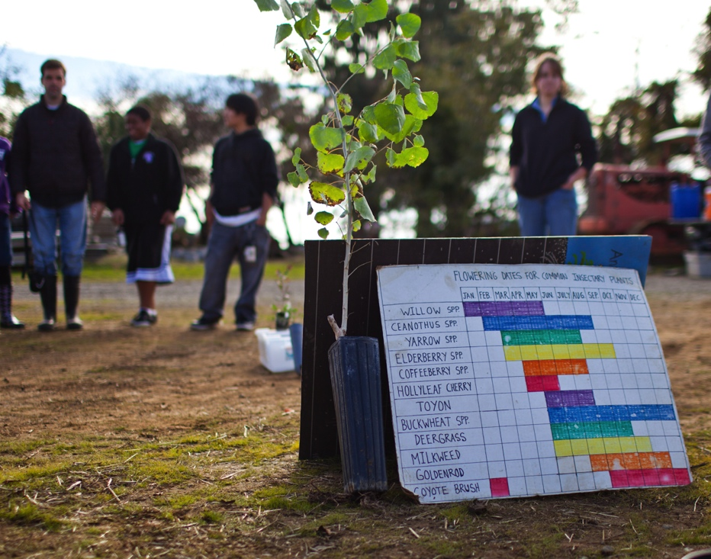
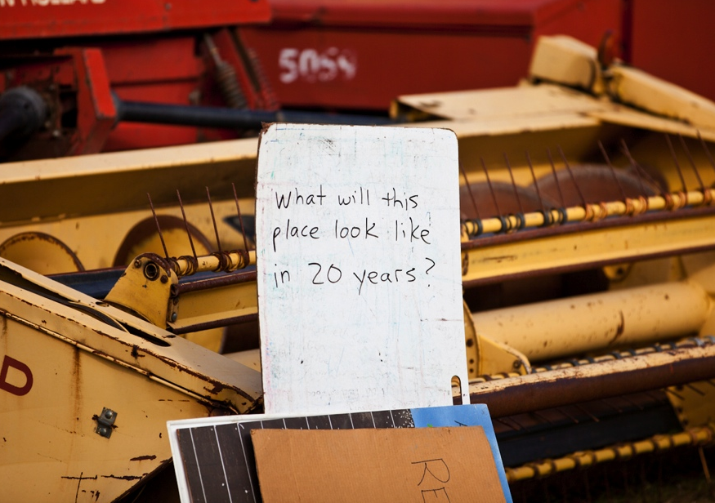
OPTIONAL LOGO HERE
OPTIONAL LOGO HERE
Student and Landowner Education and Watershed Stewardship (SLEWS) Program in Napa
A program of the Center for Land-Based Learning implemented in Napa by the Napa County Resource Conservation District
About the SLEWS Program
Methods
SLEWS Project Locations
Next Steps
The SLEWS (Student and Landowner Education and Watershed Stewardship) program combines land-based education with watershed stewardship. We provide a diverse group of students with hands-on learning opportunities in order to cultivate stewardship, community and connection to the watershed. SLEWS program staff work closely with local partners and private landowners to engage students in the process of restoring wildlife habitat on farms, ranches and open spaces. The program is offered to students in the Sacramento, San Joaquin, Napa and Sonoma Valley watersheds. In Napa, the SLEWS program is implemented by the Napa County Resource Conservation District.
Participating SLEWS schools commit to a year-long project that evolves from season to season according to the restoration cycle. Field trip activities might include seed collecting, plant propagation, planting native vegetation, building and installing bird boxes, removing invasive species, installing irrigation equipment and monitoring. The SLEWS program provides standards-based classroom curriculum for teachers, and helps teachers take advantage of their site as a place to introduce or emphasize classroom concepts. The SLEWS experience further serves to introduce students to possible careers in agriculture and natural resource conservation, while developing their skills as leaders.
The SLEWS Program methodology is based on site adoption, collaboration, mentoring, and project enrichment.
Site Adoption – Two separate classes of high school students each adopted a restoration project and visited their site three times throughout the year. These riparian ecosystems adjacent to vineyards provide benefits to the agricultural operation as well as the watershed as a whole. Over time, site adoption leads to a sense of ownership as students begin to witness the changes that take place as a result of their hard work. The sense of ownership, commitment and caring they develop for their adopted sites set the foundation for a broader commitment and caring for the natural world.
Each year the SLEWS program matches each high school class with a new habitat restoration project. Most SLEWS projects are on private land in partnership with local landowners.
Two high schools participated in the 2010-2011 school year.
SLEWS Site Map
Napa High School adopted a
habitat project on Doak
Creek in Oakville. The
property is owned by Robert
Mondavi Vineyards and is
part of the famous To Kalon
vineyard. The site is part of a
multi-year riparian restoration
project located roughly 1 mile
upstream of the confluence
with the Napa River. The
students helped create a
healthy riparian corridor
around the creek by planting
many different native plants
and removing invasive
species.
New Tech High School adopted a project at Scott Creek, a tributary of Carneros Creek in the Carneros region of Southern Napa. Students helped to restore a section of the creek by helping plant various native plants, stabilize the creek banks, and remove invasive plants. This work is part of a larger restoration project on the property in which three earthen dams and a road crossing were removed to create a continuous stream channel.
The 2011-2012 SLEWS year looks very exciting! For the first time in Napa, three high school classes will be participating in the program. The participating schools will be: Napa High School, Justin Siena High School, and St. Helena High School.
Through a new partnership with The Land Trust of Napa County, the students will be working at the Archer Taylor and Wantrup Preserves on their SLEWS field days. Students will be participating in many unique activities, including: trail building and maintenance, removal of invasive plant species, and planting of native species. The Land Trust properties will be an excellent outdoor classroom setting in which to teach the students about local ecology and resource conservation.
Funding for next year’s program has generously been provided by Friends of the Napa River, the Jack L. Davies Napa Valley Agricultural Land Preservation Fund, the Hess Collection Winery and the North Bay Watershed Association.
Collaboration - Collaboration among restoration partners, teachers, students and landowners is essential to our program success, both on the ground and in the classroom. We bring our stakeholders together to plan and implement effective and engaging projects, evaluate the program, and celebrate our accomplishments. This approach allows new program participants to contribute their energy and ideas while benefiting from the experience of others. Our reputation for implementing high quality habitat restoration projects with high school students continues to attract more partners, landowners and teachers to the program. As a result, the network of organizations and individuals it takes to run the program effectively continues to grow, as does our impact geographically.
Mentoring – We recruit community volunteers and professionals from partner organizations to serve as mentors for participating students at all of their field days, allowing the students to work and learn alongside natural resource professionals. A 5:1 student to mentor ratio on all projects ensures the highest possible quality of our projects and the best possible experience for our students.
Enrichment – Although the focus of the student field days is on the restoration project, we enrich the restoration experience for our students by integrating project work with teambuilding, hands-on learning and reflection. The SLEWS Program provides standards-based science curriculum for the classroom that prepares students for and follows up from SLEWS field day activities.
Goals of the SLEWS Program
Accomplishments
Funding
Our goals are to:
Provide real-world projects that engage students in habitat restoration in their watershed.
Match students with ethnically, socially, and culturally diverse mentors from the agriculture and environmental science fields.
Bring together students and adults from diverse ethnic and cultural backgrounds who work successfully as a team toward a common goal.
Give students the opportunity to channel their sense of caring for the environment into action that makes a positive difference on the ground and in their communities
Show students and the community how to enjoy a productive yet sustainable
relationship with the land,
resources and wildlife.
Launch students on paths
of lifelong learning, particularly
encouraging students to
continue their educations
after high school.
Napa High School at Doak Creek:
24 students participated in three field days
Over 60 native trees and shrubs planted
12 Kestrel boxes built
200+ sq. feet of invasive plants cleared
Weeding, mulching and other maintenance performed
New Tech High School at Scott Creek:
22 students participated in three field days
100 native trees and shrubs planted
300+ invasive plants removed
Weeding, mulching and other maintenance performed
The SLEWS program is made possible by grants from local organizations. This year’s projects were graciously supported by:
North Bay Watershed Association
Napa Valley Community Foundation
Friends of the Napa River
Mondavi Vineyards
Contact information
Stephanie Turnipseed
Napa SLEWS Coordinator
Napa County Resource Conservation District
707-252-4188 ext 111
steph@naparcd.org
Nina Suzuki
SLEWS Program Director
Center for Land-Based Learning
530.795.1544
nina@landbasedlearning.org

